Slide 1


THE YEAR OF THE DATA DRIVEN MARKETING
TURN INSIGHTS INTO ACTIONS

Slide 2
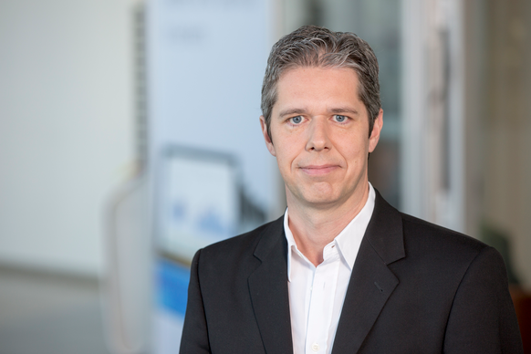



OUR AWESOME TEAM
Markus Frank
  Managing Director AOL Germany
Alex Timbs
  Head of Data and Attribution International
Fritz Heymann
  Data & Attribution Specialist Germany

Slide 4























INVESTED IN CULTURE & CODE
PARTNERSHIPS
*
2 EMMY
NOMINATIONS
DESIGN
RELAUNCHES
UK LAUNCH
LAUNCH ON PBS
PARTNERSHIPS
DESIGN
RELAUNCH
FEATURED
ON HBO
CULTURE
CODE
LEADING
DSP
* The Yahoo acquisition is pending and the closing is subject to the satisfaction of certain conditions, including shareholder and regulatory approval.

Slide 5
THE YEAR OF THE DATA DRIVEN MARKETING
TURN INSIGHTS INTO ACTIONS

Slide 6

CMO
CIO

Slide 7
THE CMO AND CIO YESTERDAY
Split into silos
CHIEF
MARKETING
OFFICER
CHIEF
INFORMATION
OFFICER

Slide 8
THE CMO AND CIO TOMORROW
Need to grow and work together
CHIEF
MARKETING
OFFICER
CHIEF
INFORMATION
OFFICER
ALLIGNED STRATEGY

Slide 9
HOW CMO’s & CIO’s CAN COLLABORATE IN TODAY’S BUSY MARKETING AND DATA ECOSYSTEMS TO OPTIMISE ROI STRATEGIES
endless creative
opportunties
360° view of the customer
to track the needs
in the right time
at the right place
efficient organization for
faster and easier reaction
on the client needs
Overwhelming big
and smart data
social media
pressure to being
top of mind

Slide 10
BETTER TOGETHER
DATA SECURITY
FUEL
TECH INNOVATION
ROI
TECH ECOSYSTEM

Slide 11
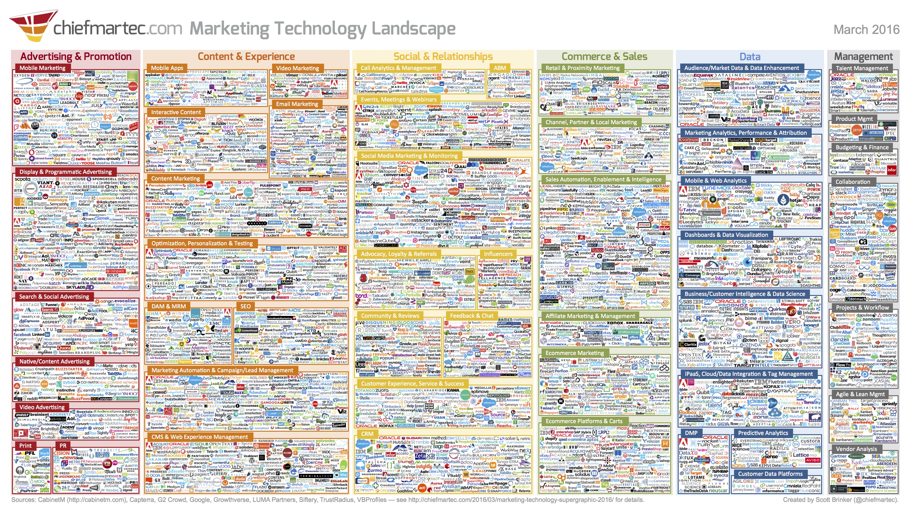

Slide 12

SIMPLIFICATION
ATTRIBUTION AS A SOLUTION
The rise of big data has increased our focus on attribution’- agree or disagree
Strongly Disagree
4%
Somewhat Disagrees
15%
Somewhat agree
33%
Strongly Agree
47%
0%
25%
50%
75%
100%
Source: AdRoll Report: State of Marketing Attribution 2016, Q4 2016, EMEA

Slide 13

WHAT IS ATTRIBUTION
Attribution is the process of identifying a set of user actions (Events or Touchpoints) that contribute in some manner to a desired outcome, and then assigning a value to each of these events.

Slide 14
AND NOW YOU – DO YOU ALREADY USE ATTRIBUTION?
RAISE YOUR HANDS!

Slide 15
DO YOU CARRY OUT FOR MARKETING ATTRIBUTION MODELLING?
Source: AdRoll Report: State of Marketing Attribution 2016, Q4 2016, EMEA

Slide 16
IF NOT, WHAT ARE THE BARRIERS?
Source: AdRoll Report: State of Marketing Attribution 2016, Q4 2016, EMEA
Notes:
As seen in the table, the issues which restrict marketers’ ability to carry out attribution or implement it properly are mainly around a lack of knowledge (58%), lack of time (44%) and technology limitations (41%). Agencies are 41% less likely to point to a lack of time as a hindrance, but they are 28% more likely to say that their clients lack the necessary knowledge.
Technology platforms generating data that is either hard to digest or not actionable enough pose a sizeable challenge for organisations, as they require specialist knowledge in order to dive into the data and extract meaningful insights.
On a positive note, less than a fifth (19%) of survey respondents cite internal politics as an issue. This suggests that while there is probably appetite for implementing attribution, organisations need to make sure that their teams are equipped with the skills necessary to make the most of the tools available

Slide 17
GOAL AND BENEFIT FOR THE CLIENTS
68%
75%
Say that understanding of customer journey/sales cycle is the goal with the highest priority
Of the companies say that better understanding of how the digital channel work together as a core benefit.
Source: AdRoll Report: State of Marketing Attribution 2016, Q4 2016, EMEA

Slide 18
SPEAK ABOUT
ATTRIBUTION WHAT APPROACHES ARE AVAILABLE?

Slide 19
DIFFERENT ATTRIBUTION MODELS
First touch
Last touch
even
U-shapE
Time decay
HUMAN BIAS I ARBITRARY I MANUAL

Slide 20





...AND THERE IS ONE MORE. THE BIRTH OF THE ALGORITHM

Slide 21
WHAT MODEL DO YOU USE?

Slide 22
MOST USED MODEL IN THE MARKET
Source: AdRoll Report: State of Marketing Attribution 2016, Q4 2016, EMEA

Slide 23
BUT WHICH ONE IS THE MOST EFFECTIVE?

Slide 24
MODEL RATING
Source: AdRoll Report: State of Marketing Attribution 2016, Q4 2016, EMEA

Slide 25
WHAT IMPACT HAS THIS?
MEANS:
BETTER PLANING
FOR MY ADVERTISING
D
VIEW
Advertisers can see through the clutter
C
ACCURATE
Accurate revenue assigned to each partner
B
LESS WASTAGE
No more spraying & praying
A
BETTER
Driving better & quality advertising

Slide 26
HOW DO WE DO THIS WITH CONVERTRO?

Slide 27


SINGLE METHODOLOGIES DON’T
SEE THE “COMPLETE PICTURE”
MARKETING MIX MODEL
Annual/semi-annual planning
Aggregated, non-user level data
Discounts digital’s true impact
No real-time updates
Slow, manual data collection
MULTI-TOUCH ATTRIBUTION
Doesn’t account for non-marketing factors
Not seeing true ROI
Misses total marketing spend
Can’t see threshold/diminishing return
Advanced tech required
Notes:
There are solutions which begin to address this paralysis. Marketing Mix Models were introduced in the ‘80’s and give executive marketers a top-down view over the factors impacting their business, along with strategic recommendations on how to spend marketing dollars. Multi-touch attribution is a different approach which has only been possible in the last 7 years, as more user-level data became available. Multi-touch attribution gives mid-level marketers actionable insights about how marketing channels are performing. Both of these methodologies have positives and negatives.
Marketing Mix Models include both marketing and non-marketing factors which impact sales/revenue. MMM typically helps users do annual or semi-annual planning across all marketing activity. Executives need this holistic view.
Multi-touch attribution builds all its recommendations and insights from the user-level up. This makes MTA great for accuracy and actionability down to the lowest levels of advertising activity. Channel managers and marketing managers need this granularity.
On the negative side, MMM uses aggregated data, so insights at more granular levels are impossible. MMM typically requires heavy manual data wrangling and can’t refresh in real-time.
MTA can’t account for many non-marketing factors, because the data doesn’t exist at the user-level. Without these additional factors, MTA results can misinterpret marketing performance.
As advertisers become more sophisticated in their marketing activities, the analytics needs have evolved as well. This means more advertisers want a single analytic tool which accounts for both strategic and tactical uses.

Slide 28





BUT MMM is incomplete
MTA + MMM
ALL CONSUMER-LEVEL TOUCHPOINTS
ACTIONABLE
CONSUMER-LEVEL OPTIMIZATIONS
No user-level insights = blunt wide reaching strategies
CROSS-DEVICE
CLARITY
Notes:
MMM has the right concept, but the execution is fuzzy. The best way to combine these two competing methodologies is to take the best capabilities of both approaches and marry them to a solid infrastructure that can account for individual consumer behavior. This framework accounts for all user-level touchpoints, addresses the complexity of our multi-device consumer media habits, and provides actionable recommendations from the highest levels down to consumer-level optimizations.

Slide 29

PEOPLE FIRST
MEANS HAVING
A 360 VIEW
Notes:
Everyone talks about consumer first or people first marketing. But to really be people-first, you need a 360 view of them.

Slide 30














THE JOURNCE IS COMPLEX
Social
Phone
Brand
Channel
Home Computer
Work Computer
Tablet
Gaming Console
Linear TV
ioT
In Store
Events
Influencers
Email
Notes:
But that’s gotten more difficult than ever. The consumer journey has gotten much more complex, and brands have increasingly more ways to reach consumers - from TV to OTT, mobile to social, email to gaming, ioT to events.
Brands have to navigate through this cluttered ecosystem.

Slide 31

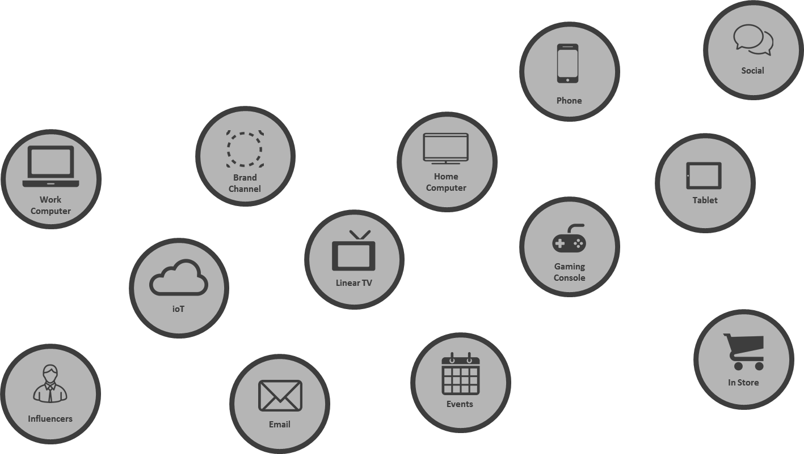

FRAGMENTED VIEW OF THE USER
Notes:
Leaving you with a fragmented view of your consumer, and preventing you from being truly people first.

Slide 32

SINGLE USER APPROACH
IDENTITY
360°
MOBILITY
NO DATALOST
MTA CONNECTS
Notes:
….painting a 360 view of the consumer that no other company can provide.
With our acquisition by Verizon, of Millennial Media, and partnership with Microsoft, we’ve become a leading global media technology company that helps you to reach 600M people around the world with this 360 view.
>>
Sources:
AOL Internal Data, June 2016

Slide 33


MACHINE LEARNING: ALGORITHMIC MODEL
Probability of Conversion
Exposure to Marketing
Notes:
LOGISTIC REGRESSION: In medicine it is used to understand the probability of certain factors influencing a patient in getting better or getting sick. In Convertro’s case, we look at marketing interactions as the independent variables (factors) that influence a customer to a particular outcome.
“Is a statistical method for analysing a dataset in which there are one or more independent variable that determine an outcome. The outcome is measured with a dichotomous variable (in which there are only two possible outcomes) so binary”
Our model refreshes weekly to give you to the most accurate attribution possible

Slide 34

CUSTOMER PATH
User-Level journey from first marketing touchpoint to final purchase!
CONVERSION EVENT
SOCIAL VIDEO SEARCH EMAIL DISPLAY
Touchpoint: any marketing view (impression) or click (visit)
Notes:
That outlines the entire customer path…
As you know paths to purchase are not linear and usually include more than one device

Slide 35
CONVERTING & NON-CONVERTING
AFFILIATE SEARCH DISPLAY SOCIAL
2 / 2 0 / 2 1 / 2 1 / 3
Notes:
The algorithm uses a logistic regression to understand which marketing touchpoints impacted or did not impact the final purchase or Conversion.
As a result, from these 4 examples we just covered:
Affiliate received 2 conversions out of 2 paths in which it was involved
Search resulted in 0 conversions out of the 2 paths.
Display converted once out of the 2 possible exposures.
And finally, Social resulted in 1 conversion out of the 3 paths.
The algorithm then goes back and analyzes ALL of the paths that occur (not just the 4, but millions of customer paths) and will assign back revenue-based credit to each and every touchpoint.
Affiliate gets a lot of credit (converts 100% of the time, and once it’s an ONLY)
Social may still get less credit…even though appears in user path 1 as converting, it doesn’t end up converting the remaining two times…riding coattails of Affiliate.

Slide 36
CUSTOMER PATH
User-Level journey from first marketing touchpoint to final purchase!
CONVERSION EVENT
SOCIAL VIDEO SEARCH EMAIL DISPLAY
€ 19 € 33 € 17 € 23 € 8
€ 100
Touchpoint: any marketing view (impression) or click (visit)
Notes:
That outlines the entire customer path…
As you know paths to purchase are not linear and usually include more than one device

Slide 37
WHAT NEXT FOR MY PLANNING?
Consider attribution for media planning to improve performance across channel and increase ROI
01
02
03
04
CROSS-CHANNEL
Knowing how each channel influences each other
ATTRIBUTE
Assigning the right credit to each touchpoint
INCREASE ROI
Generating more revenue for less investment
ACTIONABILITY
Having the tools and insight to act fast

Slide 38








TURN DATA INTO ACTIONS
improve performance automatically
0100010100010
010101011001
0100010100010
010101011001
ROI
BID TOOLS
DSPS
IMPROVED
RESULTS
IMPROVED
RESULTS

Slide 39
JOINT MARKETING APPROACH
So easy you can’t believe it
CHIEF
MARKETING
OFFICER
CHIEF
INFORMATION
OFFICER
ROI

Slide 40


