Slide 1
D3con – Hamburg 20.05.2011
Looking for parallels
Oliver Whitten – Director Demand Development EMEA

Slide 2
AGENDA
A Look Back….Way Back
Opportunities
Challenges and Risks
Industry Hurdles
Our Vision

Slide 3
HISTORY OF DATABASE MARKETING
<fname>
<lname>
<address>
<phone>
<gender>
<age>
<HHI>
Age of Catalogues
(1880-1980)
Ages of Lists
(1880-1980)
Era Analytica
(1990-2000’s)

Slide 4
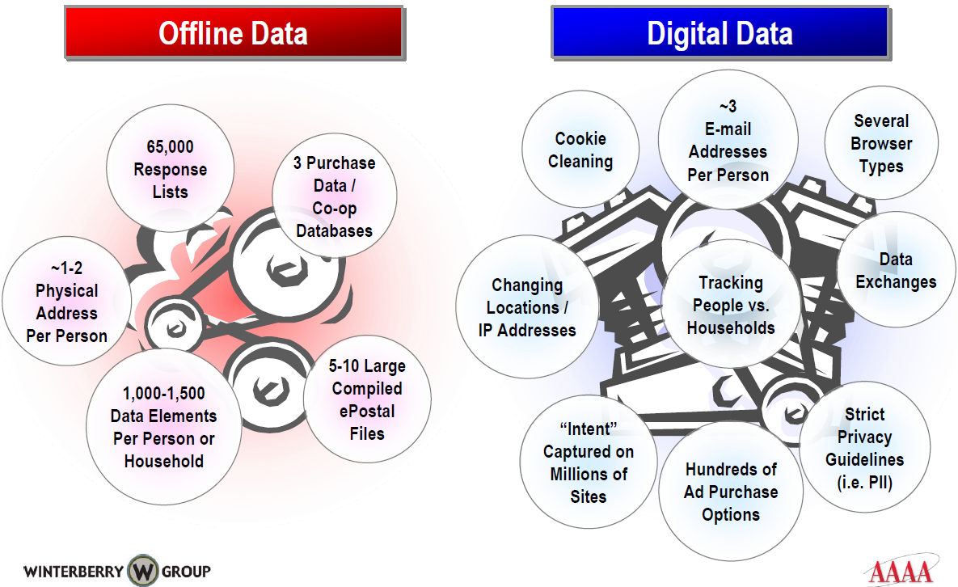
OFFLINE VS. ONLINE DATA SOURCES

Slide 5
EVOLUTION OF ONLINE ADVERTISING
Today
2007
2001
1994
Online Advertising 1.0
Editorial as a Proxy for Audience
(1994-2001)
0-$6.0BN
Online Advertising 2.0
Search as a Proxy for Audience
(2001-2007)
$6.0-20.0B
Online Advertising 3.0
Data as a Proxy for Audience
(2007 - today)
$20B and growing

Slide 6
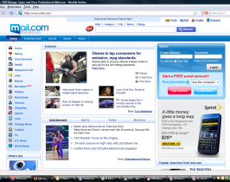
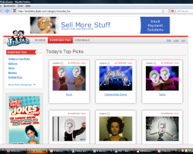
EVOLVING VALUE OF AN IMPRESSION
Placement
Site, Zone, section, etc.
Ad size
ATF/BTF
Session Queue
Audience
Demographics
Behavior
Interests
Purchase intent
Psychographics

Slide 7
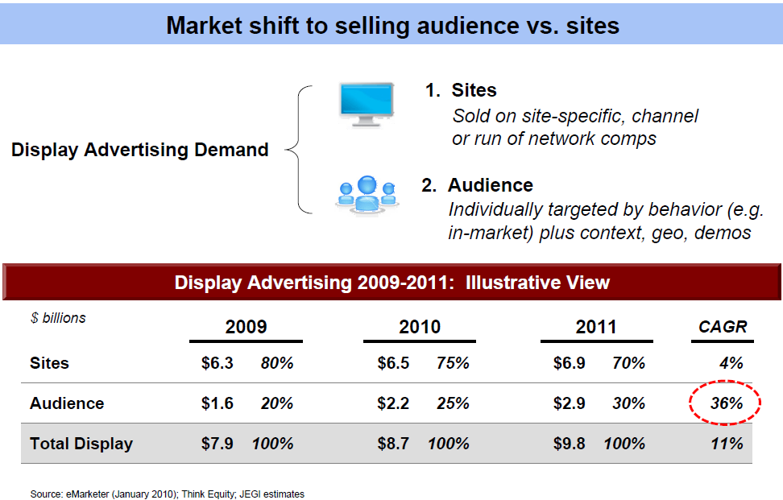

Slide 8
OPPORTUNITIES
Ad Product Innovation
Development of new products and inventory segments at premium rates on site
Audience Extension initiatives which enable publishers to target known segments offsite
Data Cooperatives
Remuneration for audience data provided to third party providers or exchanges or direct of audience segments to advertisers
Yield Optimisation
Maximising yield of direct sold campaign by optimising by placement and audience attributes
Leveraging RTB bid data to discover audience pockets of inventory valuable to publishers
Efficiencies in buying and selling via RTB

Slide 9
CHALLENGES AND RISKS
Data Leakage
Diminishing Perceived Value of Premium Editorial
Arbitrage
Lack of Understanding on the Value of Each Impression

Slide 10
HURDLES FACING THE INDUSTRY
Data Quality and Standardization
Ownership
Publisher, Agency, Advertiser, Consumer, or all or none of the above
Cost vs. Value
Attribution – Moving beyond the click as the metric for measurement
Legislative & Privacy Concerns

Slide 11
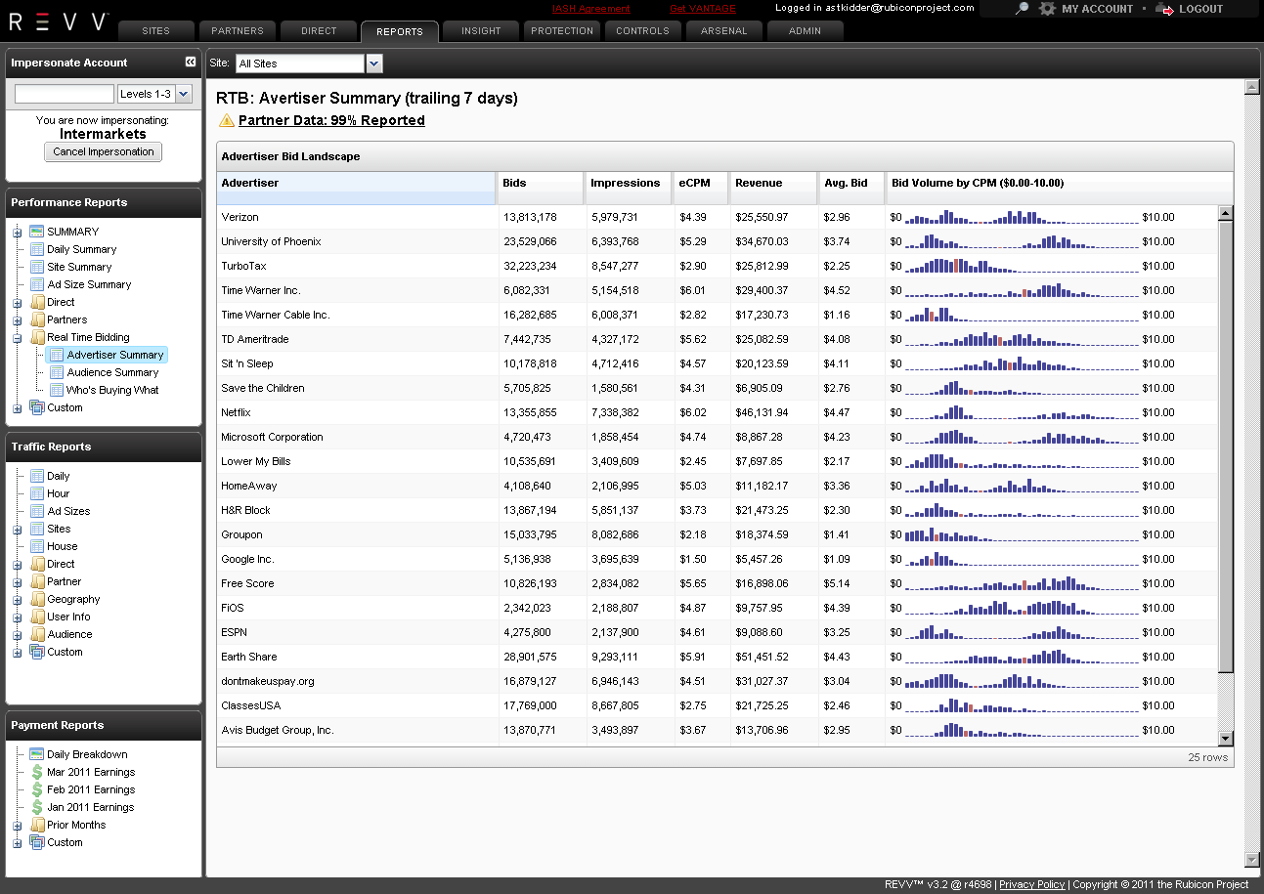
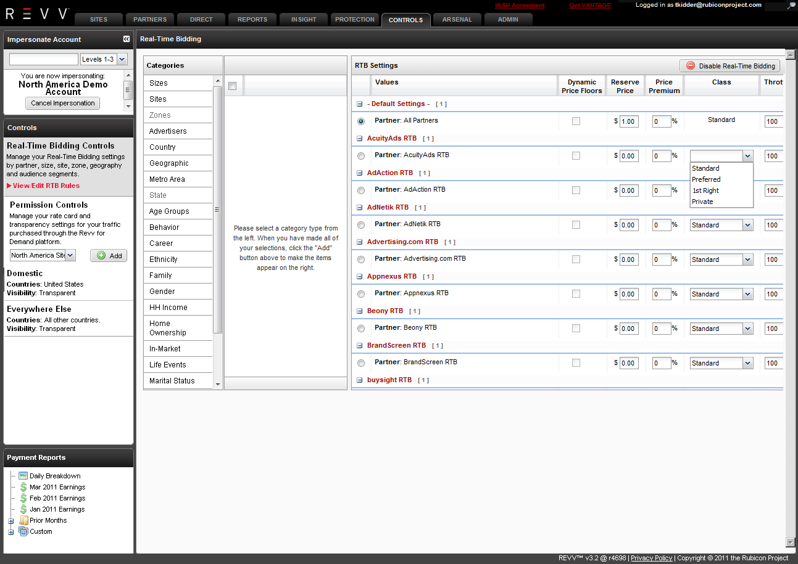
OUR VISION
intelligence
CONTROLS
Protection

Slide 12
THANK YOU!
MOST INNOVATIVE COMPANY – AMERICAN BUSINESS AWARDS 2010
“COMPANY OF THE YEAR” ALWAYSON ONMEDIA 2009
2009 TiE50 WINNER
2008 ALWAYSON 250 GLOBAL WINNER & ONMEDIA 100 WINNER TWIISTUP3 BEST IN SHOW PRICEWATERHOUSECOOPERS – ENTRETECH BEST STARTUP AMERICAN BUSINESS AWARDS - STEVIES ‘08 FINALIST BEST NEW COMPANY AMERICAN BUSINESS AWARDS - STEVIES ‘08 FINALIST MOST INNOVATIVE COMPANY AMERICAN BUSINESS AWARDS - STEVIES ‘08 FINALIST NEW PRODUCT OR SERVICE – SERVICES
#24 ON FAST COMPANY FAST 50 READER FAVORITES

